Slide 1
INTERGRATED COMMUNICATION STRATEGY
ON
AFRICAN GROWTH AND OPPORTUNITY ACT FORUM
1- 4 NOVEMBER 2023
JOHANNESBURG EXPO CENTRE,
GAUTENG

Slide 2
CONTENTS PAGE
Background and Overview
Communication Objectives
Communication Environment
Key Messages
Messengers, Audiences and Channels
Communication Approach
Communication Phases
Communication Plan
Content Plan
Media Plan
Digital Plan
Advertising, Marketing and Branding Plan
10. Safety and security Communication Plan (only available on restricted version)
11. Crisis communication Plan (only available on restricted version)
12. Communication Workstream: Structure and Process

Slide 3
BACKGROUND AND OVERVIEW
  What is AGOA ?The African Growth and Opportunity Act (AGOA) is a United States Trade Act, enacted on 18 May 2000 as Public Law 106 of the 200th Congress. AGOA has since been renewed to 2025. The legislation significantly enhances market access to the US for qualifying Sub-Saharan African (SSA) countries. Qualification for AGOA preferences is based on a set of conditions contained in the AGOA legislation. To qualify and remain eligible for AGOA, each country must be working to improve its rule of law, human rights, and respect for core labor standards.
  The African Ministers of Trade Consultative Meeting on 15 October 2021 agreed that Republic of South Africa (RSA) host the next AGOA Forum in 2023. The US administration concurred with the proposal during the AGOA Ministerial meeting on 21 October 2021.
  Cabinet Lekgotla in March 2023 approved an item for the ICTS Cluster: “Ensuring the security of energy and water supply during the 2023 African Growth and Opportunity Act (AGOA) Forum hosted by South Africa in August 2023”.
  The Department of Trade, Industry and Competition in partnership with the Department of International Relations and Cooperation (DIRCO) will host the 2023 AGOA Trade and Economic Cooperation Forum from 1 - 4 November 2023 at the Johannesburg Expo Centre. This will be the third time AGOA Forum is hosted in Southern Africa after Zambia in 2011 and Mauritius in 2003.
  The Forum seeks to expand and deepen trade and investment relationship between the United States and Sub-Saharan Africa (SSA), encourage regional integration and further reaffirm Africa’s position as a capable economic partners for the world. The Forum will be the last hosted in SSA before June 2025. It will provide a platform to lobby for renewal of AGOA beyond 2025 with SA included.

Slide 4
BACKGROUND AND OVERVIEW
The AGOA Forum will consist of the following elements:
  The Formal AGOA Forum, with representatives of governments, and business/labour delegates
  A Forum of African Trade Ministers
  A possible AfCFTA Council of Ministers meeting
  Private Sector Forum
  A Labour Forum
  A Civil Society Forum
  Forums on competition policy, trade administration, technical standards and development finance
  An industrial Exhibition, with industrial products
  African cuisine plus food and beverages
  A display of African history, film and music
  Official dinner and VIP lunches (organised by SA)
  Closing reception (organised by USA)
  Possible community visits

Slide 5
BACKGROUND AND OVERVIEW
The Forum is expected to be attended by seven hundred (700) delegates, comprising of 35 sub-Saharan Africa (SSA) Trade Ministers including SA, the United States Trade Representative (USTR), a US Congress delegation, African Regional Economic Communities (RECs), civil society, organised labour as well as business sector representatives.
The Forum will feature a Made in Africa 7362 sqm exhibition for 500 companies across the 32 SSA companies (200 from South Africa and 10 per country) in the following AGOA focus sectors: Agricultural products, Automotive, Chemicals, Metals and minerals, Mining and machinery, Clothing and textiles, Leather and footwear; and Boatbuilding
Key objectives
To host a secure world class AGOA Forum. Provide a positive experience for all attendees.
Ensure uninterrupted energy supply
Secure high-level participation of the US Administration and Congress
Expose the US Administration and Congress to the socio-economic challenges currently faced in SA.
Ensure that there is a robust substantive programme focusing on key issues that should drive SSA and US Economic relationship.
Successful lobbying for renewal of AGOA beyond 2025 with SA included.
Reaffirm Africa’s position as a capable economic partners for the world.
Strategic Importance
Possibly the last forum hosted in RSA before the expiry date of June 2025
Deliberations key to influencing extension of the programme beyond 2025.

Slide 6

COMMUCATION ENVIRONMENT
General media headlines – AGOA – 1 May to 10 October 2023

Slide 7
COMMUCATION ENVIRONMENT
An analysis of general media headlines shows a strong focus on:
South Africa and US in AGOA poultry deal deadlock.
South Africa to host key US-Africa forum in November, minister confirms.
Angola makes historic food exports to United States under AGOA.
Ebrahim Patel wants better envoys.
SA championed the voice of the African continent at UNGA, say Cabinet.
SA's access to AGOA helps neighbouring countries, says Patel.
SA pushes for renewal of AGOA to stimulate investment across the continent.
Patel warns of risk that SA’s AGOA trade could slightly diminish.
South Africa urges US government to extend Agoa.
South Africa's decision to host US-Africa trade summit sparks diplomatic tensions.
SA needs to take advantage of hosting AGOA, says economist.
South Africa will host the 20th AGOA Forum from 2-4 November 2023.
Godongwana, Patel meet top US trade official over AGOA.
South Africa government officials head to US to save AGOA trade deal.
AGOA expulsion could lead to rocketing chicken prices.

Slide 8
COMMUCATION OBJECTIVES
To profile and market South African companies, goods and services that are currently being exported under AGOA as well new products and services that present an opportunity for South Africa to export to the US under AGOA; and
To showcase how AGOA is contributing to the development of these focus sectors and indirect benefits to communities.
To build lasting networks and establish collaboration with the Sub-Saharan Africa countries to increase intra-Africa trade;
To position and rebrand South Africa as a Value-Added Partner of choice; and as an investment destination of choice;
To showcase the vibrant South Africa’s creative industry.

Slide 9
PROPOSED MESSENGERS AUDIENCES AND CHANNELS
Audiences
Channels
Key Messengers
Local and International Business and Investors
Government stakeholder (national; provincial; municipal)
Civil Society and wider South African public
Local and International Media
Public (Government audience segmentation)
Youth and women
Media Briefings
Websites (Presidency; InvestSA; IDC; GCIS; Brand SA)
Broadcast Media (radio and TV- local and international)
Community media
Print media (local and international)
Digital Media
President of the Republic of South Africa
Minister in the Presidency
Minister of Trade, Industry and Competition
Minister of Finance
Minister of Small Business
Minister of Police

Slide 10
Target Audience
Domestic
Regional
International
SA Private Sector (incl SA Multinationals)
South African Citizens
SMME’s that can and do benefit from AGOA
Continental Private Sector
Continental SMME’s that can & do benefit from AGOA
Government (Trade) representatives
US Government representatives
US Private Sector
Global Multinational (base in SA)

Slide 11
COMMUCATION PHASES
Phase One: September to October 2023 – setting the scene
Pre-Forum
Phase Two: 1 to 4 November 2023 – action and output driven
During- Forum
Phase Three: November 2023 – December 2025 – communicate outcomes
Post-Forum

Slide 12
COMMUCATION APPROACH
BRANDING
MARKETING
ADVERTISING
Marketing makes the audience aware of AGOA and Forum, engages them, and subtle helps them to buy into an idea of AGOA. Branding gives the Forum an identity, makes is memorable. Advertising helps you reach the right audience with positive, targeted messaging
CONTENT
Content development is an important process because it encourages communicators and content creators to consider why they’re communicating.
MEDIA
DIGITAL
Media relations will help us get our messages out into the wider public consciousness, and gives you the chance to inform them about what you do, why you do it, and why you're the best at what you do
Digital platforms have the potential to improve the accessibility of AGOA Forum content, facilitate conversation, and spur two-way communication.

Slide 13
COMMUCATION PHASES
Pre the Forum
During the Forum
Post the Forum
Toolkit
Engagements with media houses
Media accreditation & advisory
Media briefing state of readiness
Stakeholder engagements
Video Production showcasing opportunities of investment
Advisories and Statements
Opinion Editorial Pieces
Daily Media Monitoring
Interviews/Briefings/Press Statements
Press Releases and Opinion Pieces
Media Hub
Live Coverage Forum of Meetings
Social Media Uploads
Websites (to be populated with information)
Presidential Statement Post Post Forum/Newsletter
Daily Media Monitoring
Media briefing on the post Forum
Media monitoring evaluation
Post evaluation meeting
Report Consolidation

Slide 14
COMMUCATION PLAN
CONTENT
Develop an integrated communication strategy.
The communication strategy will integrate the content, media, marketing, digital, safety and security; and crisis communication plan.
Develop toolkit:
Fact Sheet content
Q&As content
Benefits brochure content
Welcome booklet content
Media guide content
Develop content for digital assets:
Posters
Banners and backdrop,
Invitations and programmes
logo applications
infographics

Slide 15
COMMUCATION PLAN
MEDIA LIAISON PLAN
A host broadcaster will be appointed for the Forum to provide clean SD and HD video as well as audio feed to the other broadcasters.
Media Centre – define technical and facility requirements, operation protocols, layout and personnel for the media centre and an ops room. (4 October 2023).
Medi tours – profile success stories of SA companies that have benefited from AGOA.
Issue media advisory calling for 300 media to register for the Forum.
The current RSVPs reflect a variety of media. SSA has requested to have the list by (15 October 2023).
As per tradition within international forums, a distinction is made between Official Media and Private Media. Official Media are government officials travelling on diplomatic or official passports. They provide photography, video, social media and media liaison support to their delegations.
Official media will have different accreditation from that of the rest of the media, allowing them access to cover bilateral meetings and other official engagements where the rest of the media are not invited.
South African Official Media will comprise of a team from dtic, DIRCO and GCIS and will share their material with the rest of the media.
Access to media facilities will be available only to accredited media representatives and press officer.
A pooling system will be used for the Forum to assist with the management of the number of media in certain areas and taking into consideration space limitations
Arrange off-record media briefing to give context and messaging on AGOA. (17 October 2023)
Host a state readiness and closing media briefings. (26 October 2023)
Host a welcome media cocktail party. (01 November 2023)
Host a Business Breakfast engagement. (26 October 2023)

Slide 16
COMMUCATION PLAN
STRATEGIC EVENTS
Business Breakfast & Media engagement
  The hosting of Pre-AGOA Business Breakfast on the 24th of October 2023 has been proposed.
  The purpose of the Business Breakfast is to give the companies an opportunity to engage with the Government on South Africa’s AGOA strategy.
  The platform will also allow business to share the successes and challenges as well as discuss possible solutions to some of the constraints (if any) they may have.
  Platform will be leveraged to share country messaging on the AGOA Forum and encourage message alignment with business. This will encourage a Team SA approach and to ensure that partners adhere to a coherent and unified message that will assist in positively positioning the country.
  It is proposed that the session be hosted under Chatham House Rules to allow for free engagement.
  Media would then be engaged in a post event briefing

Slide 17
COMMUCATION PLAN
STRATEGIC EVENTS
Media Welcome Cocktail
  A Media Welcome Cocktail is being planned for the 1st of November.
  The purpose of the event will be to build enhanced relationships with media and positively position the country.
  The aim is to also expose media to a strategic location in the city such as Constitutional Hill / Nelson Mandela Centre of Memory.
  Platform will be leveraged to share country messaging on the AGOA Forum

Slide 18

COMMUCATION PLAN
ADVERTISING, BRANDING AND MARKETING PLAN
Once logo and look n feel is approved:
Produce and broadcast, in high-definition (HD), video content to promote and raise public awareness on the Forum
Utilise strategic touch points such as Airport activation and branding, outdoor around the NASREC area.
Content will also include “welcome messages” to delegates at Key international Airport as well as some Did you knows on the “attractiveness of South Africa as an investment destination.
Marketing collateral
Banners
Backdrops
Promotional material at media tours
Forum packs for delegates
Forum packs for media
Approved Logo

Slide 19

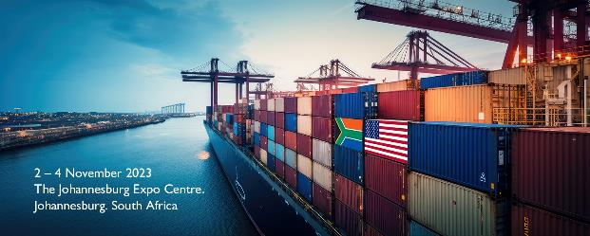
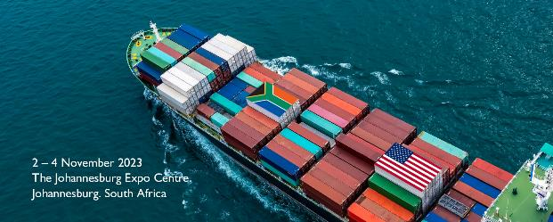
COMMUCATION PLAN
ADVERTISING, BRANDING AND MARKETING PLAN

Slide 20
COMMUCATION PLAN
ADVERTISING, BRANDING AND MARKETING PLAN
Radio advertisements
Television advertisements (count-down clock)
Print advertisements, airport advertising
Billboard advertisements
Online and social media promotion
Radio advertisements on public information via the host city communication team and NatJoints on road closures during the Forum.

Slide 21




MARKETING COLLATERAL
Email signature
Signage
Pull up banner
Facebook banner

Slide 22
COMMUCATION PLAN
DIGITAL PLAN
Digital Objectives
The digital strategy aims to guide the content approach and rollout in support of the AGOA Forum. It will be implemented in three phases; pre, during and post.
Build awareness of South Africa as a competitive investment and business destination
To profile South Africa’s regional strength and influence in global forums
To educate, inform and keep South Africans engaged on government priorities and global agendas that stimulate economic growth
To promote the theme: Partnering to Build a Resilient, Sustainable and Inclusive AGOA to Support Economic Development, Industrialisation and Quality Job Creation
Proposed hashtags:
- #AGOA2023
- #USAAFRICATRADE

Slide 23
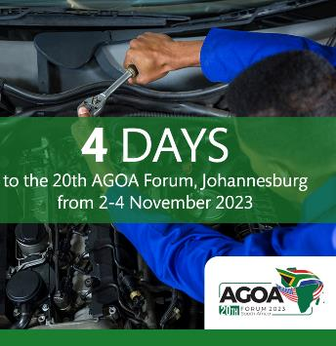
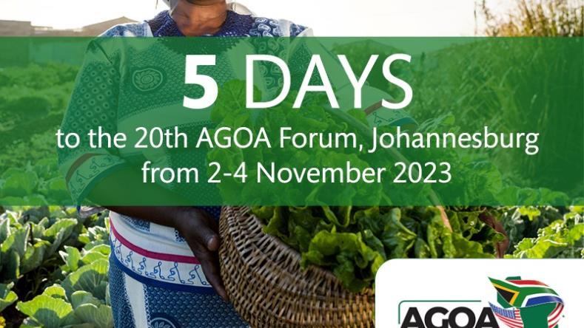
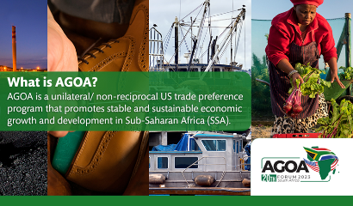



Countdown Graphics

Slide 24





COMMUCATION PLAN
DIGITAL PLAN
Digital Platforms
LinkedIn
Twitter/ X
Facebook
Instagram
YouTube (Livestream)
Official website: WWW.AGOAFORUM.CO.ZA (tbc)
Campaign Elements
Live Tweeting
Infographics
Photos and short-form videos
Paid Media
Social Media Covers
Implementation Partners
The digital strategy will be executed through partners’ existing social media platforms. These include:
Brand South Africa
DTIC
GCIS
GGDA
Proudly South African
Expo Centre Johannesburg XPO CENTRE
AGOA PARTNERS (TBC)
DIRCO
BUSA
BLSA
AMCHAM
TRANSNET

Slide 25
Structure and process
Structure
The IMC is chaired by Ministry of dtic
The chair is supported by:
DIRCO
Police
Finance
Presidency
Tourism
DARRLD
Communication Workstream is chaired by Brand SA
The supported by:
dtic (Agencies)
GCIS
SAPS
Process
The AGOA Forum has IMC overseeing it.
The Communication Workstream reports to the IMC on strategic guidance, and
The Communication Workstream reports to the NatJoints on operations and implementation.
Communication Workstream has a responsibility to ensure the seamless coordination and participation of relevant departments and agencies towards the successful planning and execution of the AGOA FORUM
The responsibility include developing concepts, strategies, plans and monitoring implementation.

Slide 26

Thank You

